Slide 1
Monthly Seminar Ho Van Phi 18-11-2019
Introduction to Heroku and Database
Notes:
https://devcenter.heroku.com/articles/getting-started-with-php#set-up

Slide 2

Heroku first class languages
Ruby, Node (JavaScript), Python & Java

Slide 3

Heroku gives you…
Developer driven deployment
Deploy using Git version control, the most popular tool for
developers

Slide 4
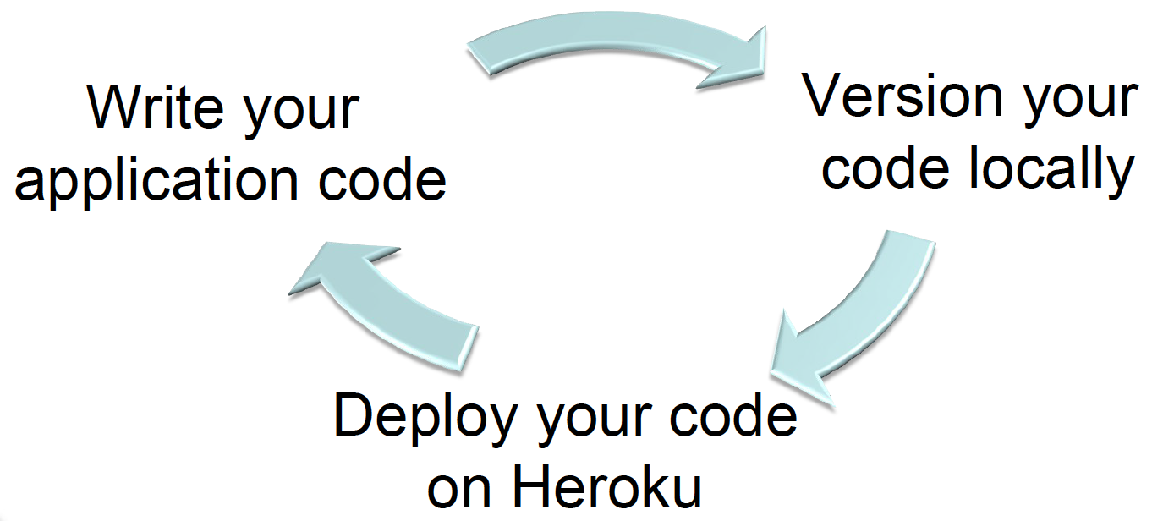
Heroku gives you…
Instant & continuous deployment

Slide 5
Hosting a PHP website on Heroku
1. Create a repo on Github
2. Populate the content
3. Config Heroku with Github

Slide 6
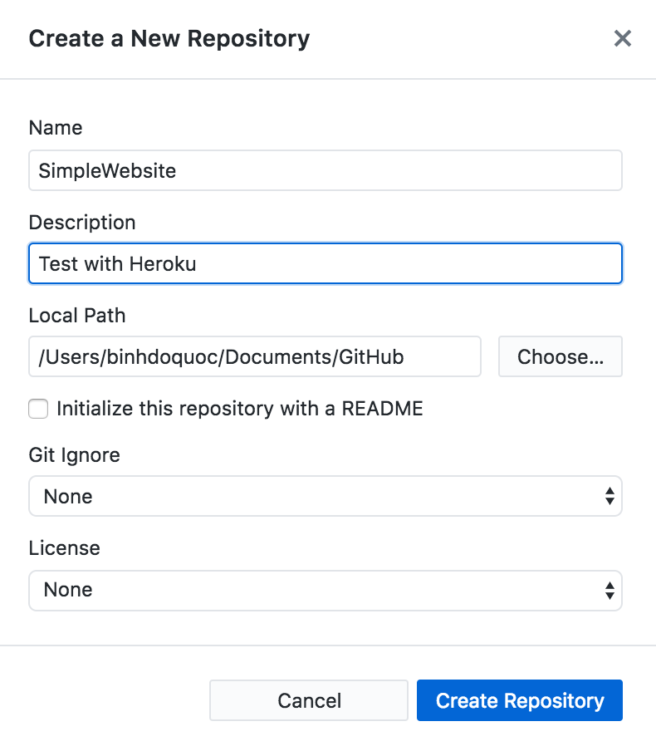
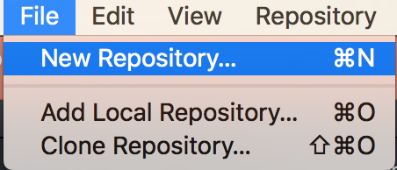

Create a repo on Github
Click here to open local folder

Slide 7
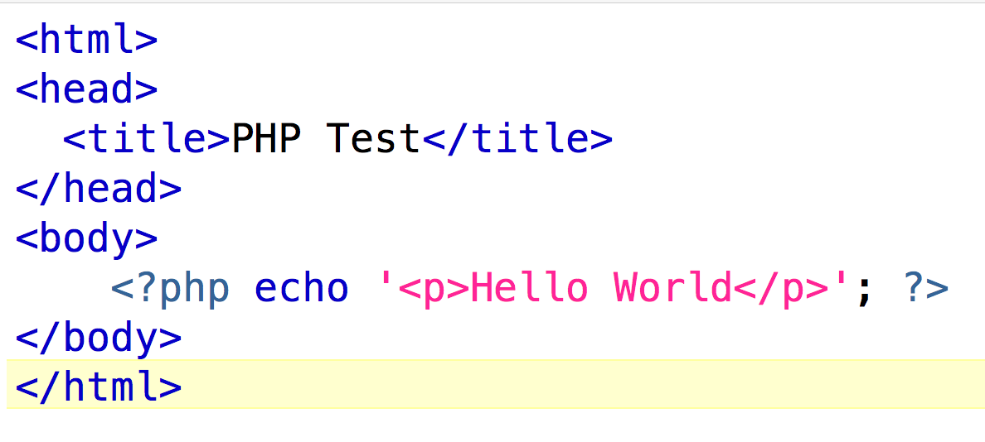
Populate content
Inside the current repo which created in the previous step create a PHP file with content like this

Slide 8
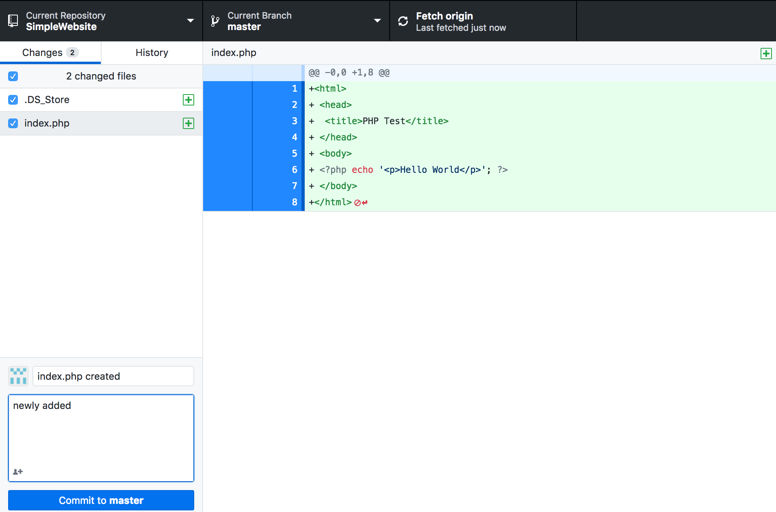
Enter comment here
Click Commit
Click Fetch origin

Slide 9
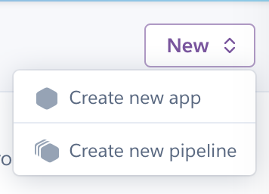
Config Heroku to Github
On Heroku Dashboard click New then Create new app

Slide 10
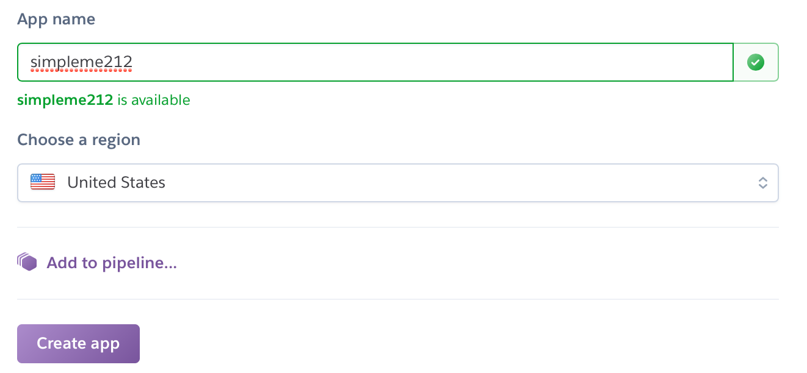

Slide 11
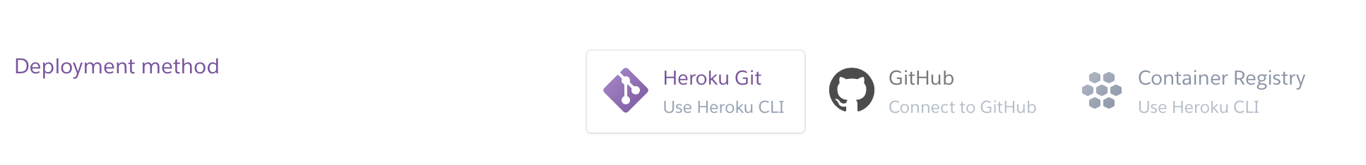
Select GitHub then Enter your login credential

Slide 12
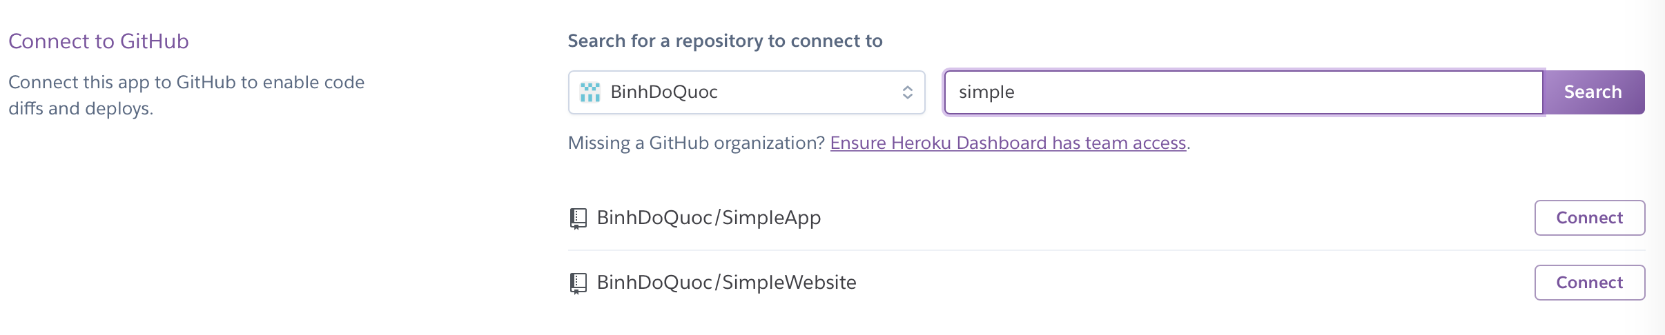
2. Select this
1.Enter Repo name and hit Search

Slide 13
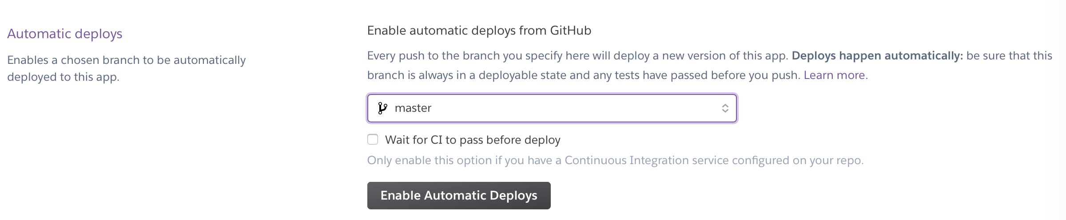
Config Heroku to Github
Select this

Slide 14
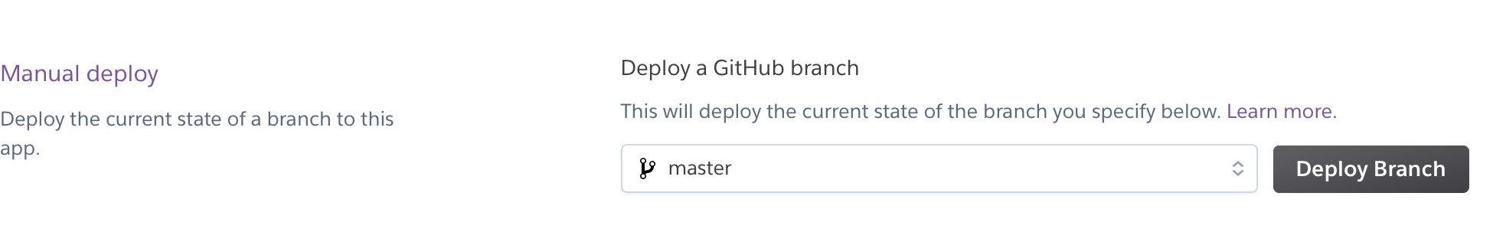
Select this

Slide 15
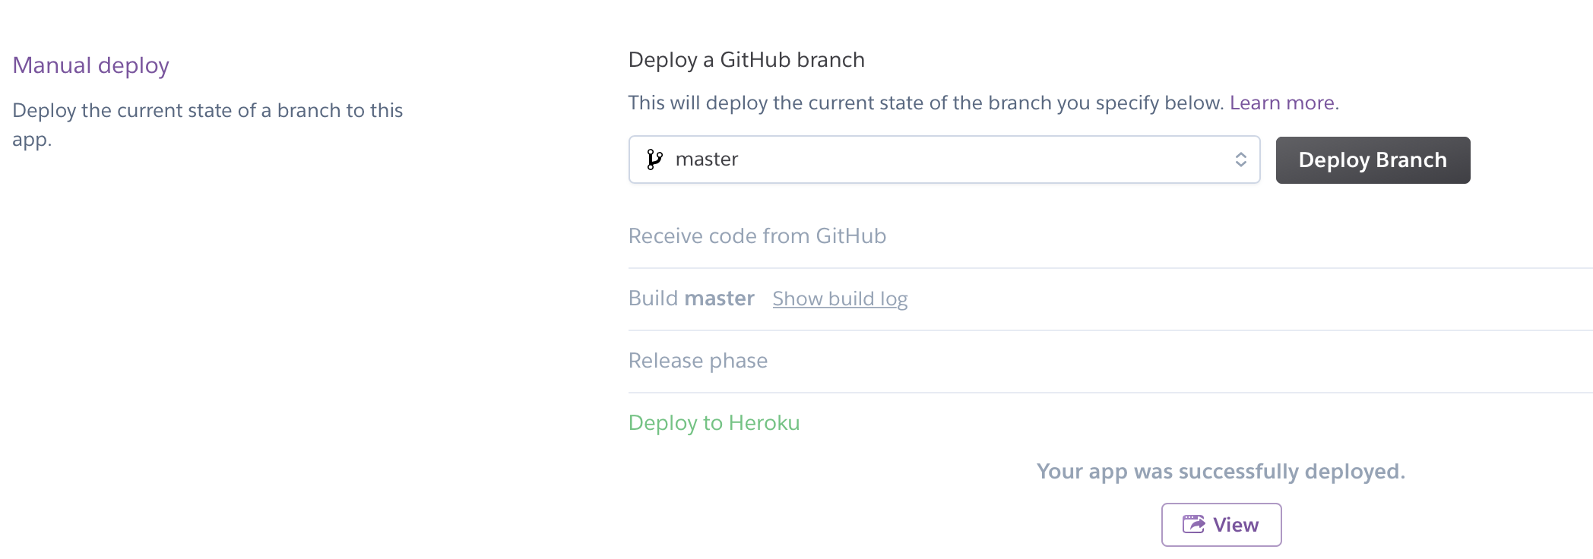
Deployed successfully
Click here to view the website

Slide 16
Database on cloud
Notes:
https://medium.com/@vapurrmaid/getting-started-with-heroku-postgres-and-pgadmin-run-on-part-2-90d9499ed8fb

Slide 17
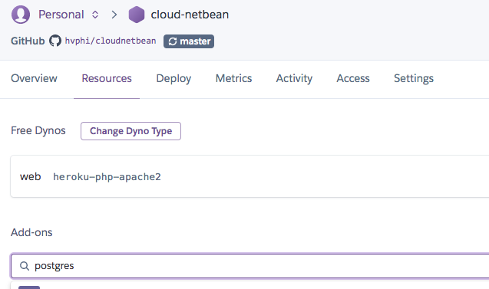
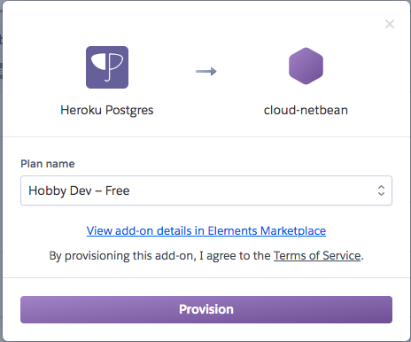
Create a new DB
From the application dashboard on Heroku, go to the ‘resources’ tab and search for postgres. Provision it and use the free option.

Slide 18

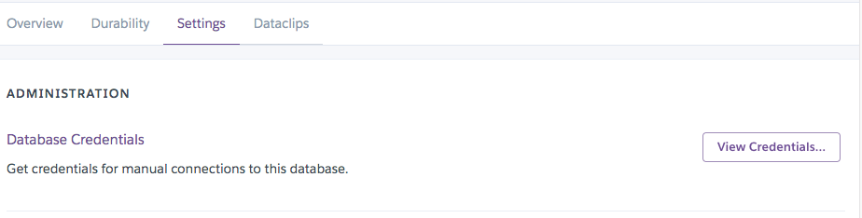
Create a new DB
There’s now a clickable link to the Datastore associated with your application.
Go ahead and open the link to your datastore, and take note of exactly how to get here again. Go to the settings tab and notice an option to reveal credentials.

Slide 19
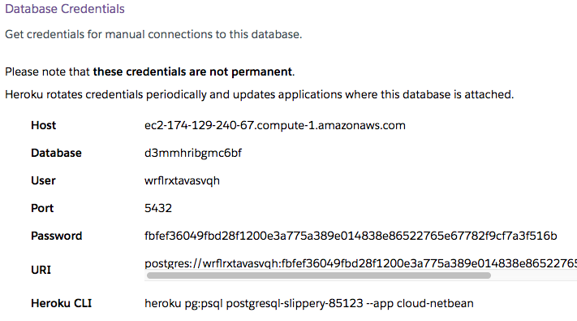
Create a new DB
Credentials:
It’s important to know how to find these credentials as they’ll be needed to communicate with the heroku database locally.

Slide 20
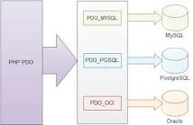
Conect to DB
Sử dụng PDO (PHP Data Object)
Statement:
$pdo = new PDO("pgsql:
host =ec2-174-129-240-67.compute-1.amazonaws.com;
port =5432;
user =wrflrxtavasvqh;
Password =fbfef36049fbd28f1200e3a775a389e014838e86522765e67782f9cf7a3f516b;
dbname =d3mmhribgmc6bf”)

Slide 21
Query data from DB
$sql = "SELECT * FROM student ORDER BY stuid";
$stmt = $pdo->prepare($sql);
$stmt->execute();
$resultSet = $stmt->fetchAll();
foreach ($resultSet as $row) {
<tr>
<td scope="row"><?php echo $row['stuid'] ?></td>
<td><?php echo $row['fname'] ?></td>
<td><?php echo $row['email'] ?></td>
<td><?php echo $row['classname'] ?></td>
</tr>
}

Slide 22
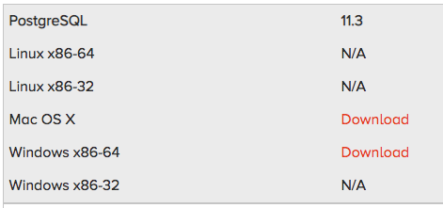
Installing Postgres/pgAdmin locally
https://www.enterprisedb.com/downloads/postgres-postgresql-downloads

Slide 23
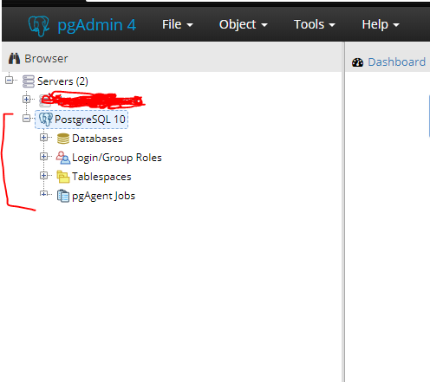
Accessing Remote Databases Locally
For a fresh install of pgAdmin, the dashboard likely contains only one server. This is your local server:

Slide 24
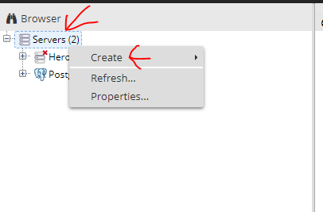
New Server
Configure a new server with those credentials.
right click server(s) > create > server …

Slide 25
New Server
Name: This is solely for you. Name it whatever you want, I chose ‘Heroku-Run — On’
Under the connection tab:
hostname/address. If you go back to your datastores ‘reveal credentials’, this is the host credential. It should look like **-**-**...amazonaws.com
Keep the port at 5432, unless your credentials list otherwise
Maintenance database — this is the database field in the credentials
Username — this is the user field in the credentials
Password — the password field in the credentials. I highly advise checking save password so that you don’t have to copy pasta this every time you want to connect.
In the SSL tab, mark SSL mode as require

Slide 26
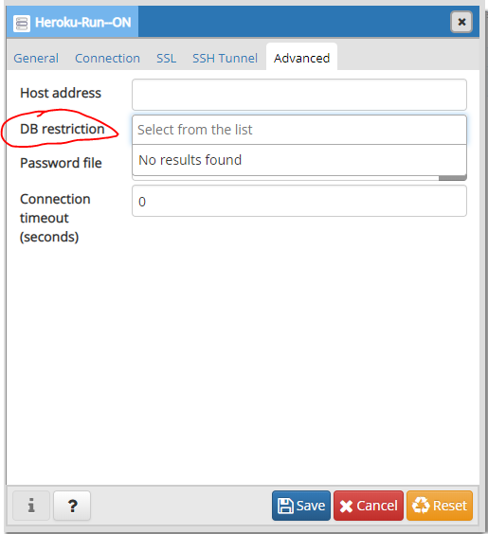
New Server
go to the Advanced tab:
under db restriction copy the database name (it’s the same value as the Maintenance database field filled earlier).

Slide 27
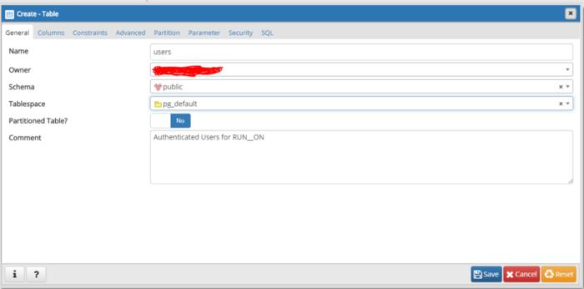
Creating Tables in pgAdmin
Expand database > database > schemas > public > Tables
Right click > create > table…
Ensure owner matches your user credential, the schema is public. Additionally I like to set the tablespace to pg_default, which is just indicating how things are stored on disk.
Table Name must be in CAPITAL characters

Slide 28
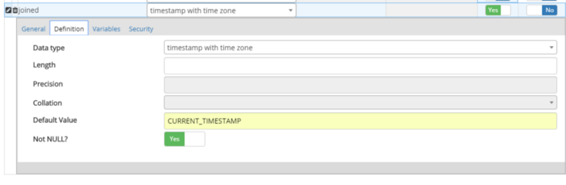
Creating Tables in pgAdmin
Under Columns tab, click add to add colunms and its data type
Use the ‘edit’ icon to the left for the joined column, as we’ll need to specify some extra details. A menu should open up. Click the ‘definition’ tab of which can be used to specify a default value:

Slide 29
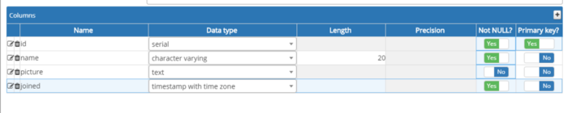
Creating Tables in pgAdmin
Re-click the edit icon to leave the menu. The column definitions look as follows:

Slide 30
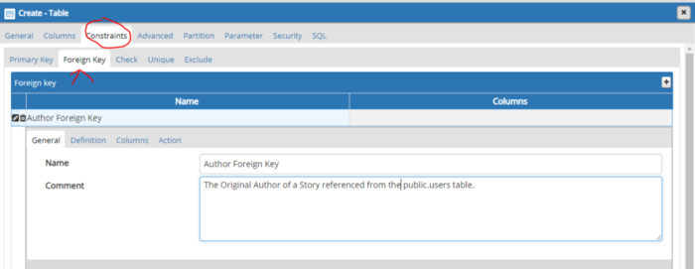
Foreign Key
Constraints tab > Foreign Key sub-tab

Slide 31
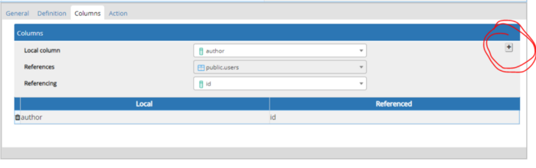
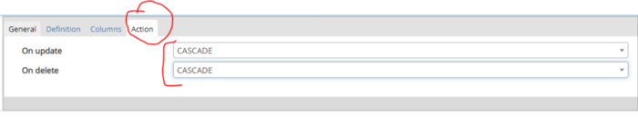
Foreign Key
Skip over to the columns tab. Fill out the information and very importantly, once it’s entered hit the little ‘plus’ sign hiding to the right.

Slide 32
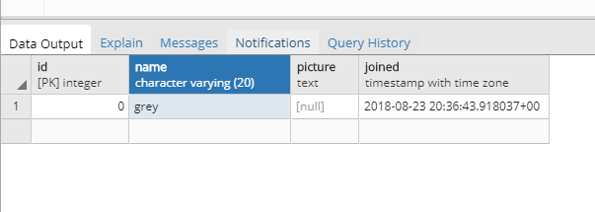
Editing Data with pgAdmin
Right click users > view/edit data > all rows

Slide 33
Thank you!
Questions?

